Slide 1
Table creation in MS-Word
Class V

Slide 2
There are three ways to create table in MS-Word
Simple table
Quick table
Draw table.

Slide 3
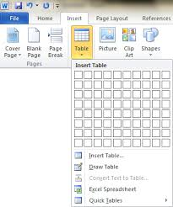

Slide 4
Open MS-Word
1. Table creation by using simple method
Step 1: Select "Insert" from the tabs below the ribbon.
Step 2: Click the "Table" icon. A dropdown box will launch.
Step 3: Determine the height and width of your table by counting
the number of cells you need up and down and across.
For example, if your table will show 5 categories of items as columns
and 4 items listed in rows, you need a table that is 6 cells wide and 5 cells
tall. The extra cells are for column and row labels.

Slide 5
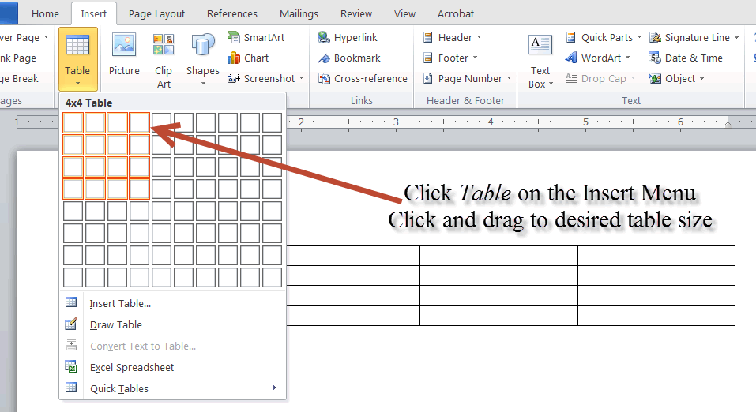

Slide 6
Step 4: Move your mouse over the blocks representing cells in the
table dropdown menu to highlight the appropriate number of
cells for your width and height requirements.
In this example, the block of highlighted cells will be 6 wide and 5 tall.
The tooltip will say "6x5 Table."
Step 5: Click the highlighted cells to create a table in your document.
Step 6: Enter the information in your table.

Slide 7
2. Table creation using Quick table:
Step 1: Click the "Insert" tab and then click the "Tables" icon.
A drop-down box with several options will open.
Choose your Quick Table style by clicking it to insert it into your document.
Step 2: Customize your Quick Table by inserting or deleting rows, columns and cells as needed.
Click the cell nearest the location where you need to add another row or column.
Right-click to access the pop-up context menu.
Mouse over the "Insert" option and choose the appropriate menu item to insert additional cells.
Delete rows by right-clicking to the left of the row in question. Delete columns by first clicking and dragging to highlight the column and then right-clicking on it for the context popup menu.
Step 3: Populate your table with the appropriate information.

Slide 8
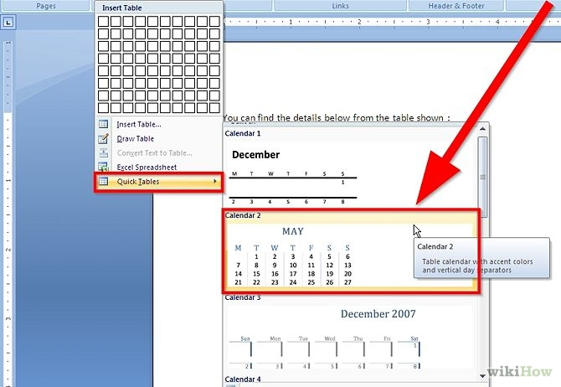

Slide 9
3. Create table using Draw table method:
Step 1: Select Draw table option.
Click the "Tables" icon from the "Insert" tab and then the
"Draw Table" menu item.
Click and drag from the upper left corner down to the lower right
corner for your rectangular table outline.
Step 2: Insert rows and columns in your table.
Click and drag inside the confines of the table outline to add
columns and rows to your table.
The cells do not need to be split evenly in columns and rows.
For instance, you can create a​ single subhead over 2 columns by
placing the column border lines.
Step 3: Use the "Eraser" icon in the "Draw Borders" section of
the "Design Tab" to remove drawn lines.
Step 4: Enter your information into the table.

Slide 10
